Slide 1
WELCOME
ICBE Lunchtime Bite-Sized Webinar
Building Mental Toughness
January 27th, 2021 @ 1pm
Where knowledge is shared and multiplied

Slide 2
Building Mental Toughness Increasing well-being and performance in self and others 27.01.2021

Slide 3
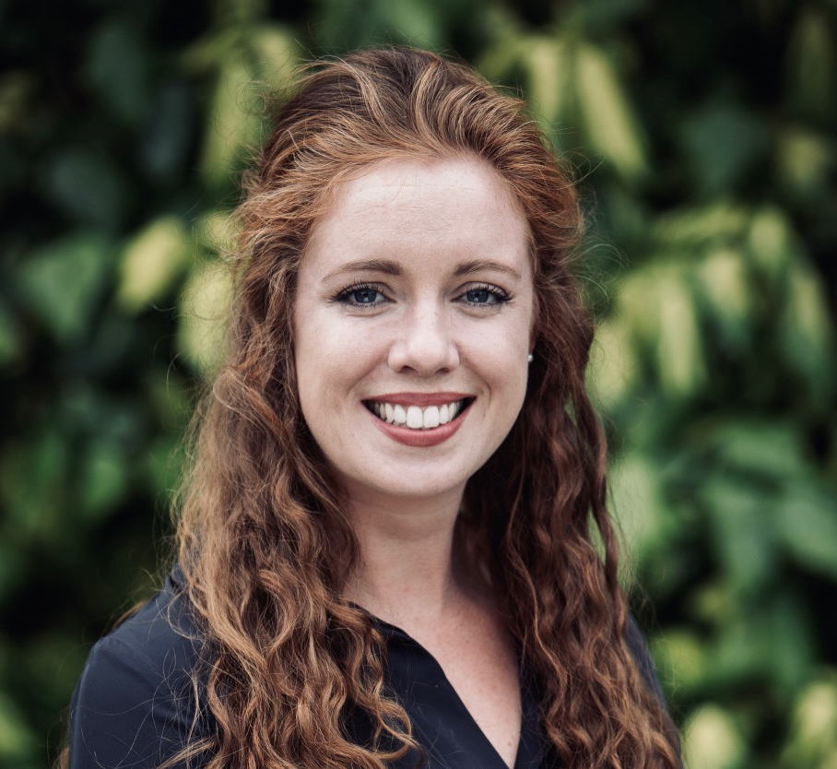
Lorna Lawless
M.A. in Applied Psychology (Positive & Coaching)
Focus on Mental Toughness through performance coaching for amateur and elite athletes
Master Trainer for AQR international
Notes:
Discussion Point – Ref Pre work

Slide 4
Notes:
Humour – opportunity to normalise the subject matter – greater understanding of the beauty of MT …. You will leave with some practical tips and an exercise you can do your self and with others.

Slide 5
What is Mental Toughness?

Slide 6
“A personality trait which determines, in some part, how individuals respond when exposed to stressors, pressure, opportunity and challenge…irrespective of the prevailing situation.” (Clough & Strycharczyk, 2011)

Slide 7
BUILDING YOUR MT MUSCLES
What you Think
How you Feel
What you Do
Notes:
Practical Tip: Building this Psychological Muscles (plasticity)

Slide 8
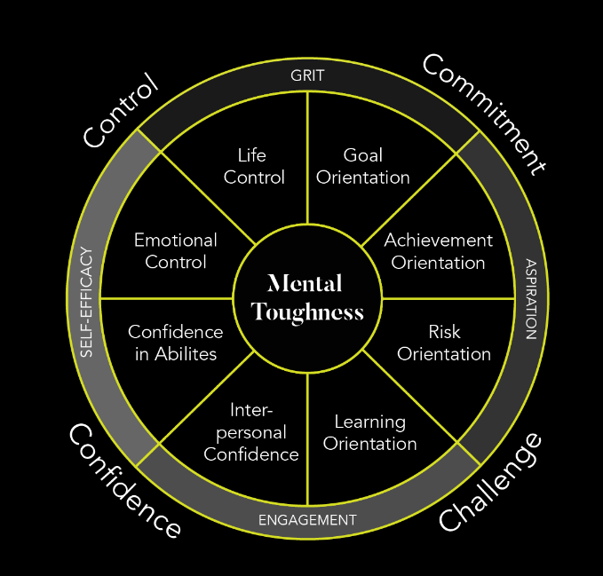
Notes:
The Model – high level with focus on outcomes
– 4 ‘factors’ – 8 elements – 4 outcomes …
Ask participants to take a picture with your phone.
This is the language we are going to be working with today.

Slide 9
Going Beyond Resilience: Why Mental Toughness?
Notes:
Poll – Is MT important?

Slide 10
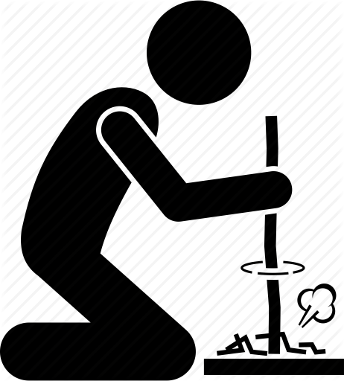
Survive
Notes:
Origins Finally Dr Peter Clough @ The University of Hull It has origins in the world of the academic and the practitioner.
Resilience Health psychology - Commitment, control – a passive concept
Hardiness Commitment, control + challenge – becoming proactive
Dienstbier - Physiological toughening = psychological toughening
Sports Psychology - MT can help lesser athletes beat more able athletes - Often mentioned but poorly defined
Finally Dr Peter The University of Hull
Defined MT in useful detail & added a fourth dimension – Confidence

Slide 11
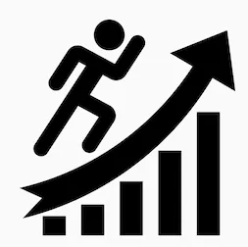
Thrive

Slide 12
Mental Toughness & Mental Sensitivity
Notes:
Both useful…
Recognise the differences….understanding, compassionate…learn how to get the best of self others…

Slide 13
BUILDING YOUR MT MUSCLES
What you Think
How you Feel
What you Do
Notes:
Practical Tip: Building this Psychological Muscles (plasticity)

Slide 14
Wellbeing . Performance . Positive Behaviours

Slide 15
Let’s Delve Deeper

Slide 21
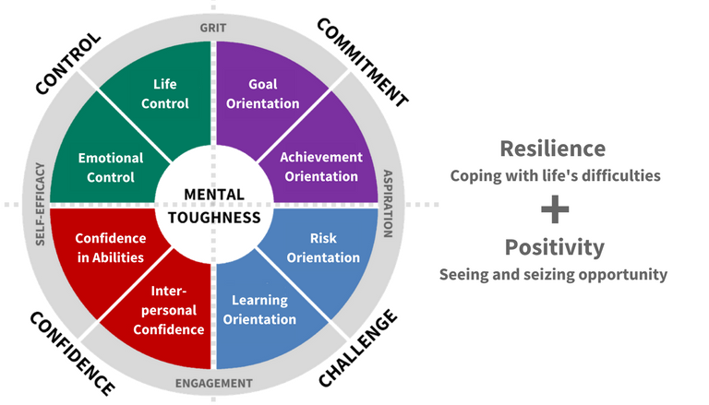
Mental Toughness
Recap

Slide 22
EXERCISE
Notes:
Think of a something that is/will be a challenge for you
E.g. Presentation, difficult conversation, etc.
We are most comfortable taking on challenges when practiced
Can you practice under similar conditions?

Slide 23
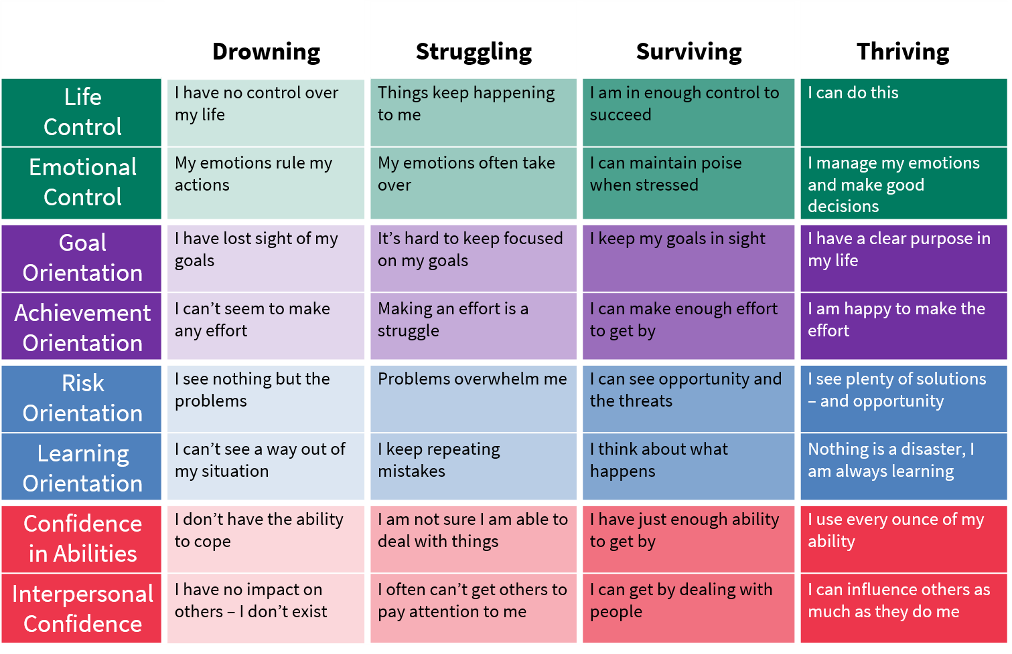
Notes:
You will get slides…
Self Assessment exercise… Pick the statements you can relate to the most per area?

Slide 24
BUILDING YOUR MT MUSCLES
What you Think
How you Feel
What you Do
Notes:
Practical Tip: Building this Psychological Muscles (plasticity)

Slide 25
Thank you

Slide 26
Any Questions?

Slide 27
Next Webinar: 11th February, Business Continuity & Risk
Website: icbe.ie
LinkedIn: Irish Centre for Business Excellence
Twitter: @ICBE_Business

