Slide 1


WELCOME
ICBE Lunchtime Webinar
‘Solving Complex Problems : Tools and Tips on improving Critical Thinking Skills’
24th Feb 2021
We will start shortly

Slide 2


Professional development of STEM professionals
to join-the-dots & solve complex problems
ICBE - February 2021

Slide 3
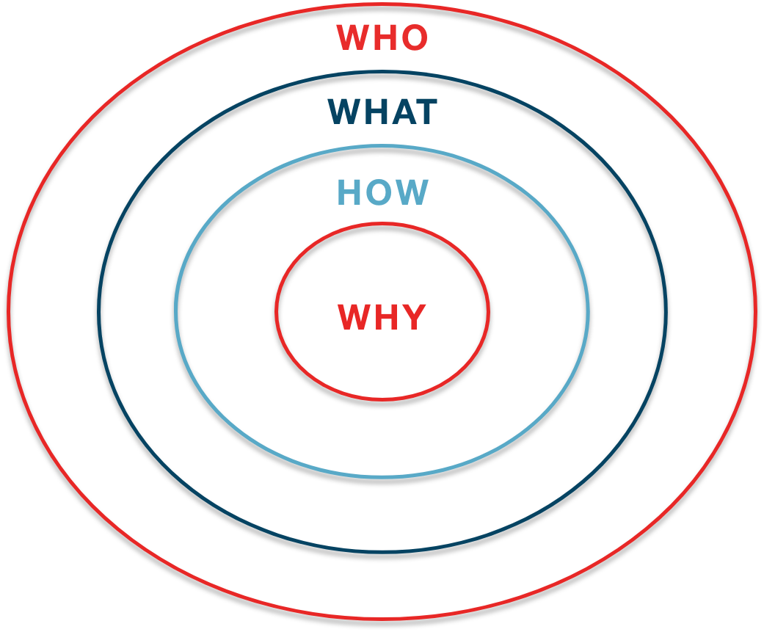

Our Purpose today
Who is Think4Purpose?
What are we preparing STEMs for?
How can we help join-the-dots for Work 4.0?
Why do we need an integrative approach?
Think4Purpose.ie | Copyright 2020

Slide 4
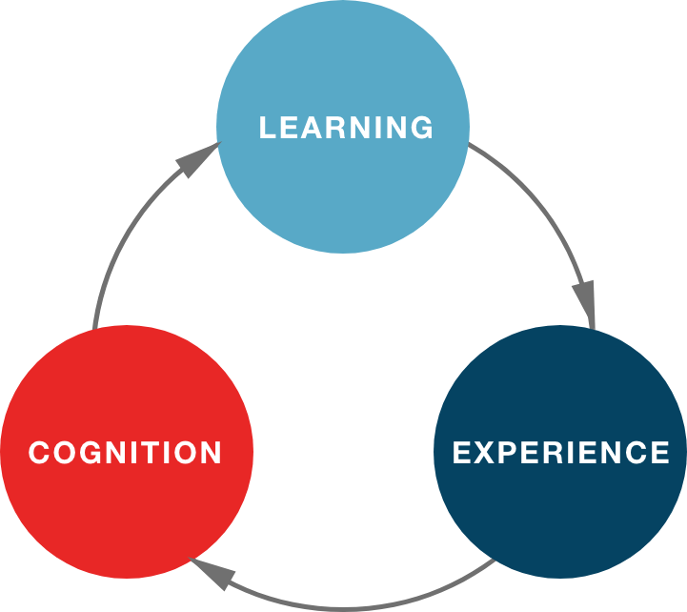
WHO?
T4P deliver coaching & virtual workshops in
Analytical., Critical & Strategic Thinking for STEM’s
We apply a Problem-Based Learning (PBL) approach combining:
Cognitive Science
Systems Theory
Behavioural Economics
Risk & Quality Management
www.think4purpose.com
Think4Purpose.ie | Copyright 2020

Slide 5
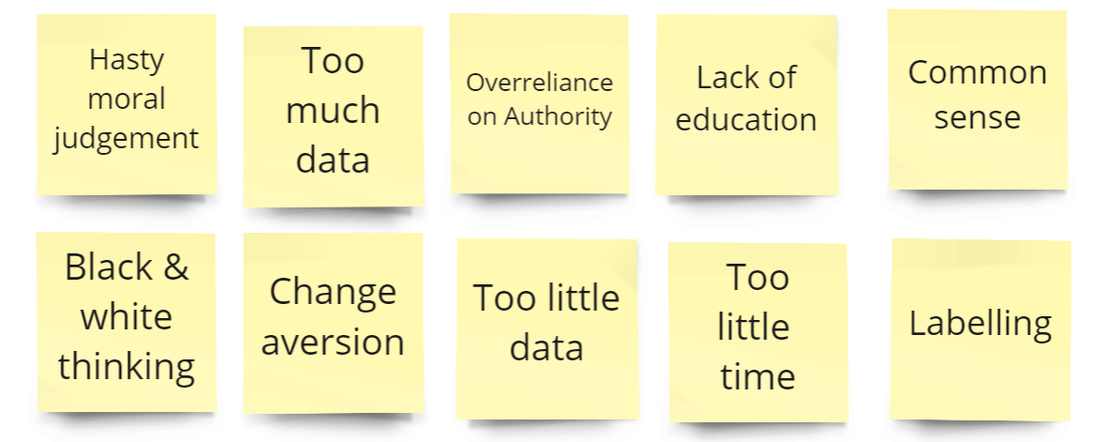
HOW - WE FAIL WE JOIN THE DOTS?

Slide 6
Good tools don’t replace good thinking
RACI
SIPOC
Process Mapping
5Y approach

Slide 7
WHAT? Work 4.0 Elements
Feedback- dominated
Adjacent Possible
Inter-related Systems
Innovation
-lead
Involvement of End-Users
Feedback-heavy
Integration
Integrity of Purpose
Iterative
Approach
Interdependent Teams
Emergence
Cross-disciplinary
Interconnected Problems
Complex
Wicked

Slide 8
WHY? V.U.C.A.
Dynamic interdependence
Predictions tricky
Meanings obscured
Low Signal:Noise ratio
Contextual decision-making & evaluation rated as main enabler of early-stage job performance
V ati
ol lity
78.9% rated ability to deal with the unforeseen in Top 3 most desired competency
Complexity
Ambiguity
Uncertainty
We all prefer to know a future event will be adverse than not knot know whether + or adverse
Poor capacity to pivot between problems reported in graduates
Think4Purpose.ie | Copyright 2020

Slide 9
HOW - Systems-based Problem-Solving
Analyse
When?
Concepts
What?
Criteria
Characteristics
Where?
Why?
Context
What next?
What If?
Criticality
Contingencies
Evaluate
Conditionals
Says Who?
So What?
What If?
How?

Slide 10
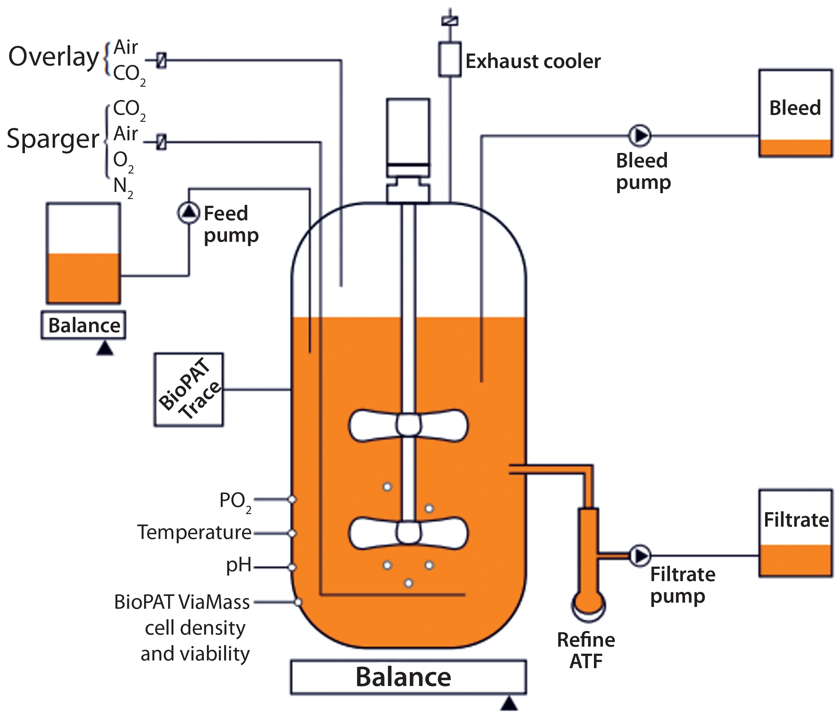
WHAT - ‘Hard’ Problems (Lel& & Richardson)
‘Solution methods & concepts needed not all known at outset’.
Multiple, dynamic variables & conflicting objectives.
Uncertainty is inherent, often including cause-effect.
Think4Purpose.ie | Copyright 2020

Slide 11
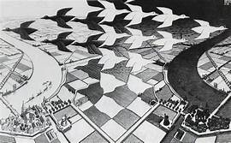
WHAT - ‘Wicked’ problems?
(Rittel &Webber; Hogarth)
Rules of the ‘game’ e.g. key constraints are emergent
Our next steps unclear with serious unintended impact.
Feedback loops are dominant but delayed – fuzzy,
Unique solutions are generally required.
Think4Purpose.ie | Copyright 2020

Slide 12
HOW – Leverage both Approaches
 | Plusses? | Possible Minuses?
Science | -Scepticism -Peer Review -Falsification Principle -Precautionary Principle (Just in case) | -Over-relies on SME’s -Reductionism works for linear problems -Can produce WYSIATI (What You See is ALL there is)
Engineer- ing | -Developing Solutions lnductively -Gathers information broadly -An integrative discipline | Over-relies on Heuristics Simplification can miss the less obvious
Think4Purpose.ie | Copyright 2020

Slide 13
HOW – Bridging disciplines
Technical & scientific knowledge is now insufficient.
Risk-based decisions require a multistakeholder approach
We need an integrated rationale.
We get back to fundamentals to make innovation work.
Explains:
Observe
Hypothesize
Test
Analyse
Solves :
Specify
Design
Verify
Validate
Integrity
Interprets :
Synthesize
Critique
Present
Justify
Defend
Think4Purpose.ie | Copyright 2020

Slide 14


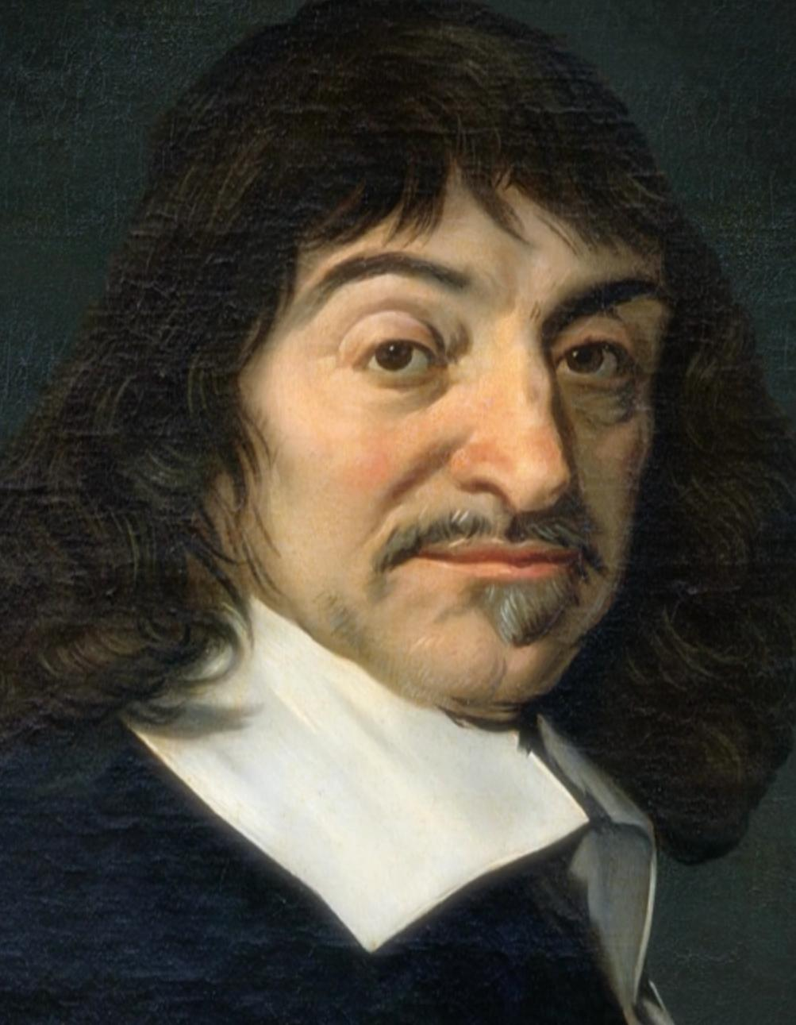
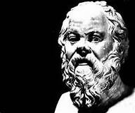
HOW – Fight Systems with Systems
TEAM
Systems Dynamics
Critical Thinking

Slide 15
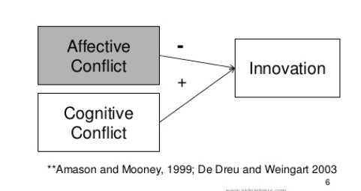
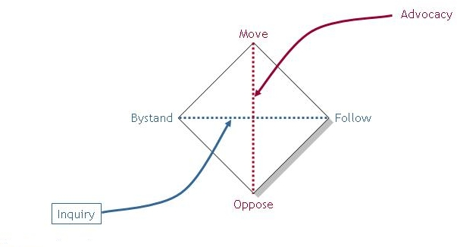
HOW – Use Dialogue – Kantor’s 4 Player Model
)

Slide 16
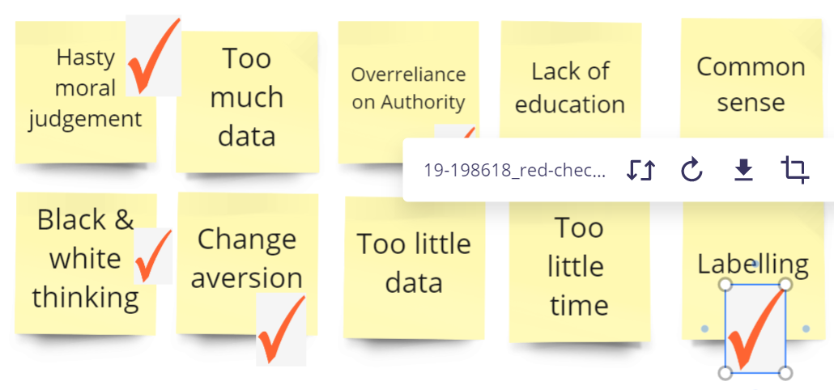
WHAT STOPS US JOINING THE DOTS?

Slide 17
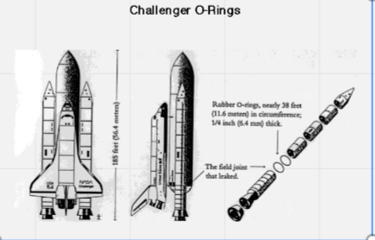


A word on Data

Slide 18
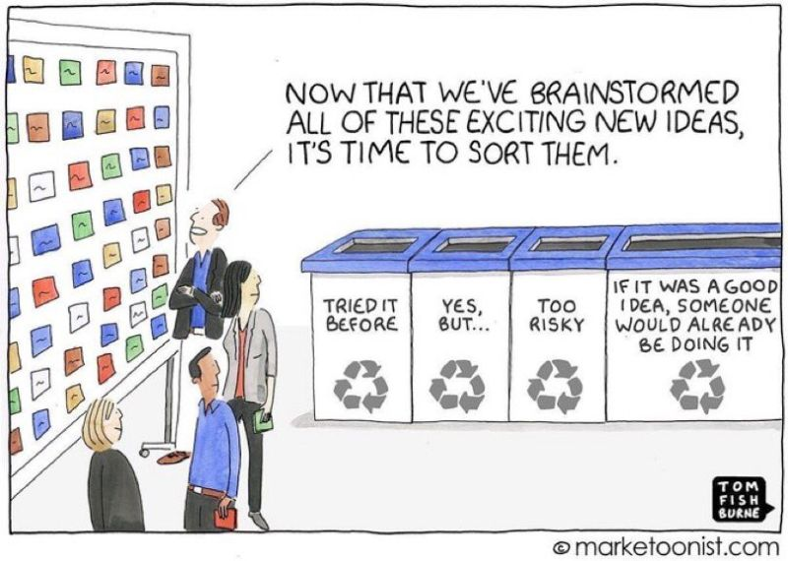
Hasty moral judgement & Labelling

Slide 19
Thank You
email fiona@think4purpose.ie
Sign up to our monthly newsletter
www.think4purpose.com

Slide 20
Website: icbe.ie
LinkedIn: Irish Centre for Business Excellence
Twitter: @ICBE_Business

