Slide 1


WELCOME
ICBE Lunchtime
Bite-Sized Webinar
Wellbeing in Remote Teams
We will be starting in a few minutes February 18th, 2021 @ 1pm
Where knowledge is shared and multiplied

Slide 2


Wellbeing in Remote Teams
What's the current picture
Psychological Safety, Wellbeing and Remote Work
Communication as a Wellbeing Tool for Remote Teams
Creating and Fostering Wellbeing in Remote Teams
Dorothy Scarry ​
BA PGCE HDipED MScWorkplace Health and Wellbeing​
​
​
Member SOM AHPI INTO Teaching Council IoH

Slide 3

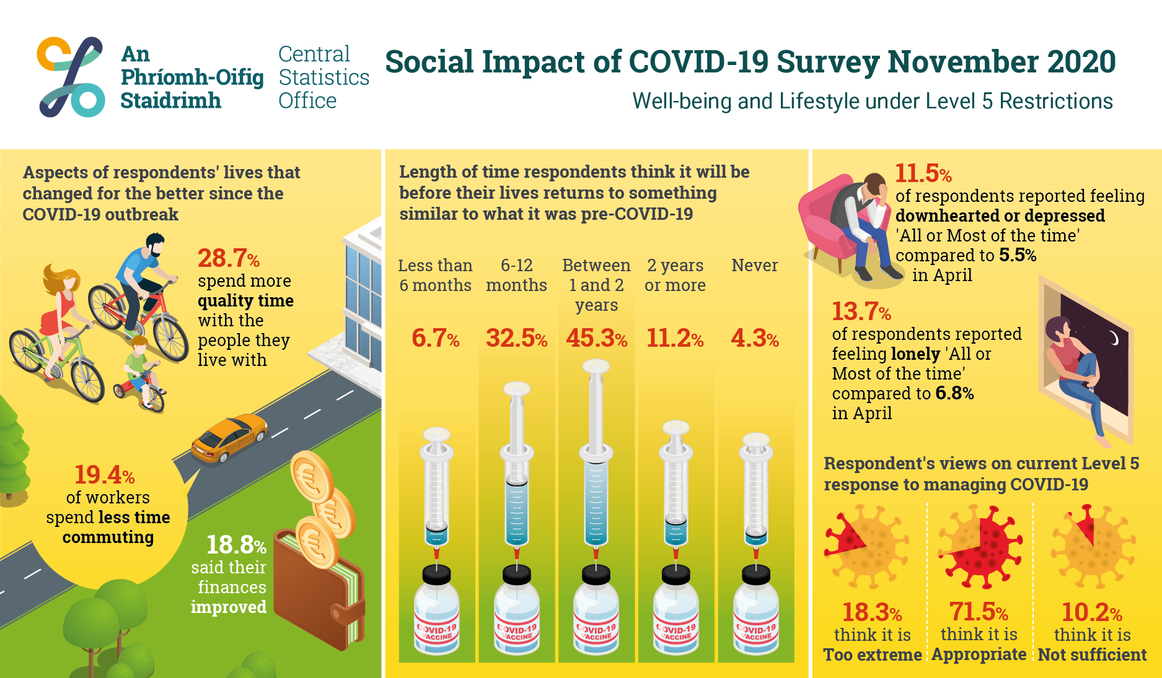
CSO –Ireland November 2020

Slide 4

Mental Health First Aid Ireland
Working from Home Survey July 2020
31.7%reported not being happy with their current work-life balance
33% frequently felt isolated working at home
59% are worried about job security
38.7% harbour health concerns for family members
40% of respondents were found to be experiencing poor wellbeing as defined under the WHO-5 Well-Being Index.
34.3% of respondents agreed that they found working at home to be motivational
57.9% agreed that they loved the autonomy that home working presented
72.6% felt trusted by their employers

Slide 5

WHO-5
HOW Are you?

Slide 6

Psycho-social Safety
Management Standard Indicator Tools
Demands
Control
Support
Role
Relationships
Change

Slide 7

Wellbeing and Remote
Working
Caring Responsibilities
Ageing Workforce
Inclusion and Diversity
Life-Style
Work-Life Balance

Slide 8

www.menti.com
CODE: 783700

Slide 9
Communication
“The single biggest problem in communication is the illusion that it has taken place.”
George Bernard Shaw

Slide 10

Supporting Flexible, Remote and Hybrid Work
Communication Board/ Trello/ Teams/Slack
Communication Diary/ Outlook
Technology-web meetings, file sharing. Choose a platform that can deliver what your team needs
Networking/Hubs
Regular Formal and Informal Team Meetings
Skillnet- Online CPD

Slide 11

Active Listening-
RASA
Receive
Appreciate
Summarise
Ask
Julian Treasure

Slide 12
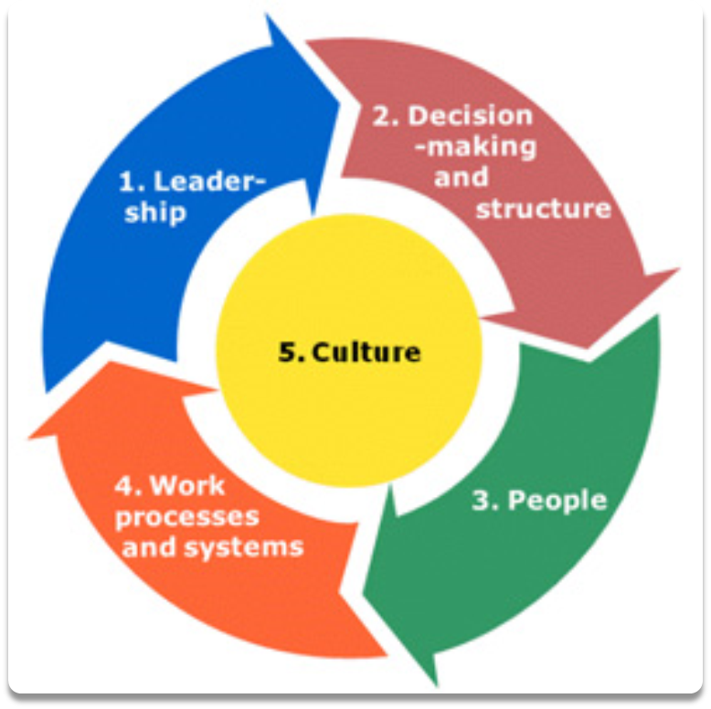
Wellbeing and Culture
The Tangible and the intangible

Slide 13


Organisational Interventions
Measurement-Where are you at?
Evidence-based Health Promotion
Psycho-social Risk Assessments
Leadership and Staff Training
Psychometric Testing for New Hires/ Promotion
Participative Action Groups/Team Meetings
Changes at Work Explained
Mental Health Champion/s/Wellbeing Team
Corporate Social Responsibility
Policies in place

Slide 14

Workplace Health and Wellbeing Ltd
Workplace Wellbeing and Resilience Training Providers
Bespoke Live Virtual Workshops
Consultation
DISC Personality Profiling
1:1 Coaching and Mentoring
w: www.workplacehealthandwellbeing.com
e: Dorothy@workplacehealthandwellbeing.com
Dorothy Scarry

Slide 15


“When a flower doesn’t bloom, you fix the environment in which it grows, not the flower”.
Alexander Den Heijer
This Photo by Unknown Author is licensed under CC BY-SA

Slide 16
Website: icbe.ie
LinkedIn: Irish Centre for Business Excellence
Twitter: @ICBE_Business

