Slide 1


WELCOME
ICBE Lunchtime Bite-Sized Webinar
Mental Health First Aid
We will be starting in a few minutes
July 7th, 2021 @1pm
Where knowledge is shared and multiplied

Slide 2



Slide 3





Martin Gillick
(MSc. Mental Health)
Manager
Mental health First Aid Ireland
Notes:
Intro and ice breaker
Name, hope and best moment in life

Slide 4
Mental Health?

Slide 5
One flew over the cuckoos nest
Manic depression
Helplines
Depression
Self-esteem
Hospitalization
Institutionalisation
Exercise
Recovery
Bipolar Disorder
Stigma
Psychiatry
“A Beautiful Mind”
Anxiety
Anorexia
Medication
Hallucinations
Anorexia
Anxiety
Schizophrenia
Stress
Bulimia
Suicide
Hope
Suicide
“Black Swan”
Black dog
Taboo
Murder Suicide
Psychotherapy
Self-harm
Panic Attacks
Hearing voices
“Black Swan”
Concentration
CBT
CBT
Schizophrenia
Help
Prozac
Support groups
Wellness
Help

Slide 6
What is Mental Health ?
How we think, how we feel about ourselves and how that impacts on our ability to make the most of our potential in life

Slide 7

According to the World Health Organisation,
450 million people
are experiencing a mental health problem right now.
Two thirds will never seek professional help.
Notes:
Mention that WHO have stated that depression will be the largest disease burden in the world by 2030.
State: “So, how does this affect performance in the workplace” and Transition to the next slide

Slide 8
What is the cost of mental health to the economy
4% of GDP – or over € 600 billion across Europe
€170 billion (1.2% of GDP) on social security programmes
€240 billion (1.6% of GDP) on indirect costs -lower employment and productivity at work
OECD, 2018
4% of Ireland’s GDP = €12.9 billon
CSO, 2018
Notes:
Total Time: 2 minutes
KEY POINTS:
170 billion EUR (1.2% of GDP) on social security programmes including sick leave benefits, disability benefits and unemployment insurance benefits
190 billion EUR (1.3% of GDP) on direct health care spending
240 billion EUR (1.6% of GDP) on indirect costs due to lower employment and productivity at work.
Source:
Health at a Glance: Europe 2018 (OECD, 2018)
Ireland GDP 2018 = €324 Billion
Source:
Central Statistics Office (CSO) 2018

Slide 9

Signs to spot at work
Increased errors, missing deadlines or forgetting tasks
Taking on too much work and volunteering for every new project
An employee who is normally punctual arriving late
Working too many hours: first in, last out, sending e-mails out of hours or while on leave
Increased sickness absence
Being fixated with fair treatment and quick to use grievance procedures
Tiredness and loss of humour
Notes:
HIGHLIGHT KEY POINTS:
CHANGE – Many times when a mental illness manifests, the person changes.
Various people have various awareness levels of their own illness.
In some cases while the signs are noticeable to the observer, the associate does not have the insight about their own state.
In the examples showed before not every affected person will show every symptom, and many of them might try to hide or mask their problems.
We should be aware of the CHANGE.
Consider asking the question: “So, What are contributing factors or triggers that can think and behave in a negative way.” Then transition to the next slide to discuss, Triggers, which can affect our mental wellbeing.

Slide 10
Useful questions to ask
How are you feeling at the moment?
How long have you felt like this – is it an ongoing issue?
Who do you feel you can go to for support?
Are there any work related factors which are contributing to how you are feeling?
Is there anything we can do to help?
Notes:
Total Time: 2 minutes
CLICK to build slide.

Slide 11
What is mental health first aid?
Mental Health First Aid (MHFA) is the help offered to a person:
developing a mental health problem, or
experiencing a mental health crisis
The first aid is given until:
appropriate treatment and support are received, or
until the crisis resolves

Slide 12

Mental Health First Aid
Notes:
Inform the audience that we are now going to provide you with an overview of the 2 Day mental health first aid programme

Slide 13
The Standard MHFA Course
The MHFA course is a 12-hour course
4 modules
Skills based:
  Signs and symptoms of mental health problems
  What sort of help has been shown to be effective
  Framework for communication
  How to offer and provide initial help, and how to guide a person towards appropriate supportive help

Slide 14
Emerging mental health problems covered include: | Mental health crises covered include:
Depression Anxiety Psychosis Substance Misuse | Suicidal thoughts and behaviours Self-harm Panic attacks Traumatic events Severe psychotic states Severe effects of alcohol or other drug use Aggressive behaviours

Slide 15
As a result of MHFA training, participants demonstrate:
Increased knowledge of how to provide MHFA
More positive attitudes to appropriate treatments
Decreased stigmatizing attitudes
More supportive behaviors to others
More confidence in providing support
When measured, studies also find improved mental health in participants.

Slide 16
























Notes:
Examples of organisations where MHFA has been used here and in UK.

Slide 17
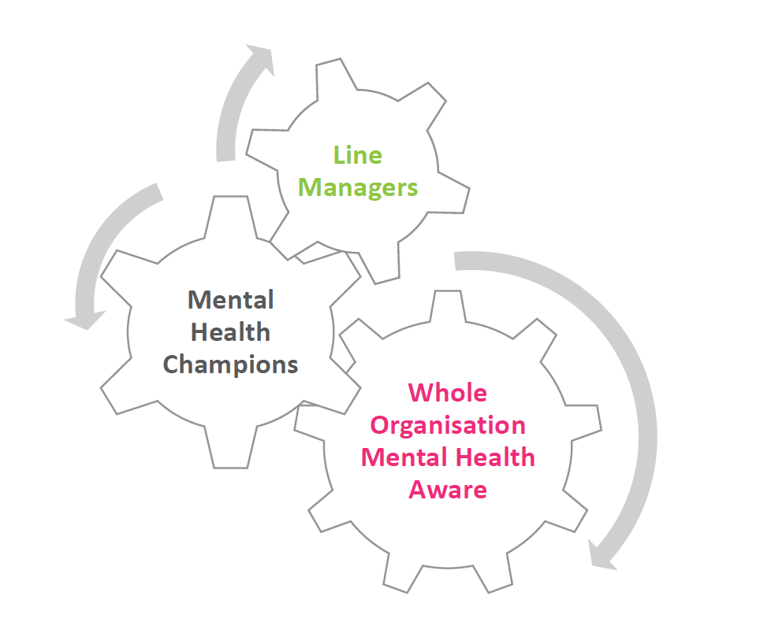
Creating a ‘whole Organisation’ training approach to support mental health for your managers and employees

Slide 18
QUESTIONS?
www.mhfaireland.ie
Tel. +353-1-2771458
Notes:
Encourage participants to learn more by doing a MHFA Ireland course very soon in person, or locally if out of country.
Tell them about any resources directly related to MHFA – such as the resource section of our website.
We will have a standard email ready to go out after to all participants with resources and contact information.
QR Code – will allow access to our website resources page

Slide 19
Website: icbe.ie
LinkedIn: Irish Centre for Business Excellence
Twitter: @ICBE_Business

