Slide 1
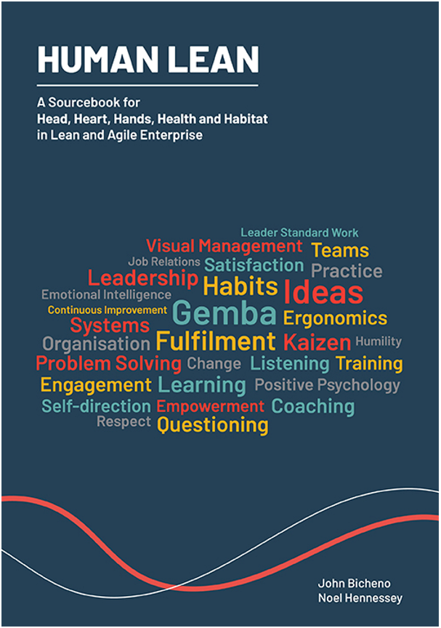
I.C.B.E. Lunchtime Bites Webinar
Noel Hennessey
Practical Lean Solutions
07-12-21

Slide 2
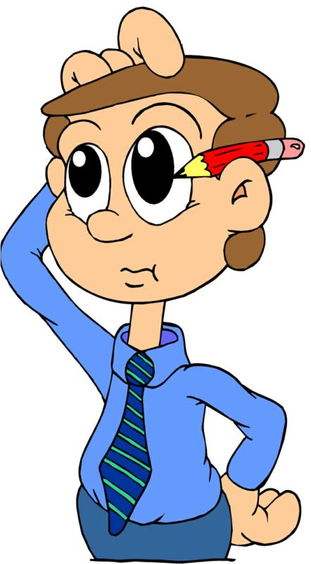
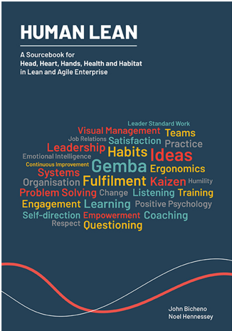
Hey Guy’s, Do we really need another book about lean?
Notes:
Although much is known about good Human practice, there remains many a gap between actual and potential performance.
>90% lean implement stations are not successful
The work of work is changing
No 1 best way to manage people

Slide 3
Exercise 1: Employee Engagement Poll
On a scale of 1 to 5 please rate employee engagement within your organisation.
5 – Highly engaged
4 – Slightly engaged
3 – Neither engaged or disengaged.
2 – Slightly disengaged
1 – Highly disengaged

Slide 4
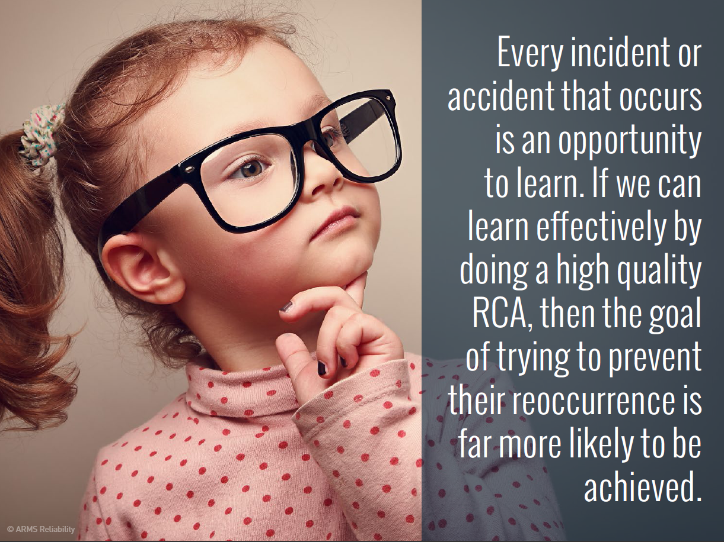
That’s great Noel, but how do we get the best out of our people?
Notes:
...in a work evironment
Powerful communication tool

Slide 5
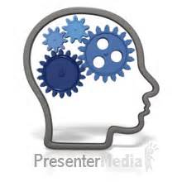
Engagement: Four Emotional Drives
There are four drives hardwired into our brains, and the degree to which they are satisfied directly affects our emotions, and by extension, our behaviours.
(Nohria, Groysberg, Lee, 2008)
Drive
Acquire
Bond
Comprehend
Defend

Slide 6
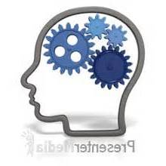
Four Emotional Drives:
Drive: | Primary Lever: | Actions:
Acquire | Reward System | Competitive Pay Policy Link pay to performance Promote on merit Opportunity to achieve full potential
Bond | Culture | Value collaboration & teamwork Encourage sharing of best practice Create a community spirit Recognition Systems
Comprehend | Job Design | Make work meaningful (answer the why) Link daily work to corporate goals Job rotation Visual Management
Defend | Performance Mgt System | Setting Expectation Build trust Open culture Honest / regular communication Transparent policies
Note: All four drivers are required to create the full benefit for both the individual & organization.

Slide 7
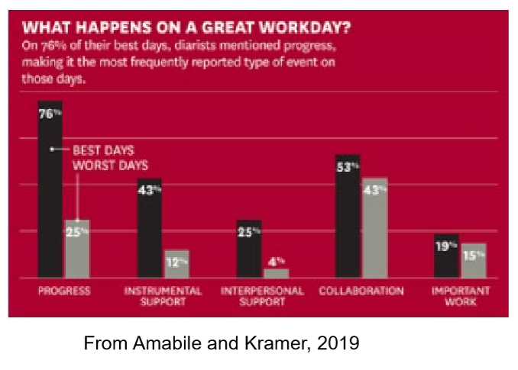
The Progress Principle
Best days were when the individual or team made progress towards a goal
Best days also featured;
Catalysts (Actions which triggered progress) &
Nourishers (build confidence & belief)

Slide 8
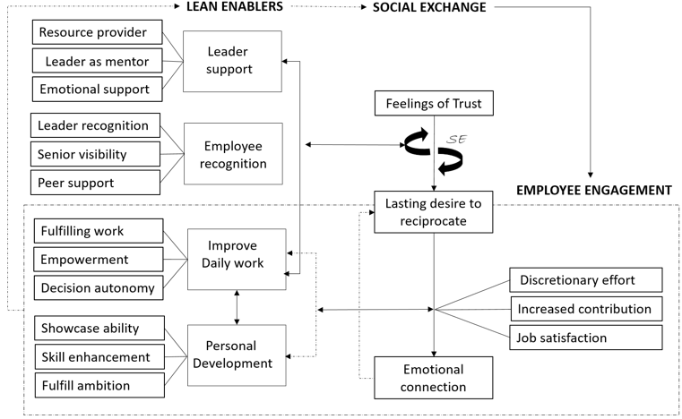
Link Between C.I. & Employee Engagement

Slide 9
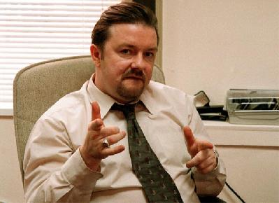
Leadership
Notes:
Site CI visit story
Create a sense of urgency. Managements responsibility to get people excited. Work shouldn't be just about making a living – it should also be about making a difference, customers, employees, community.
Work like a football match

Slide 10


Exercise 2: Toxic Boss
Have you ever had the misfortune to work with, or even worse, work for, someone with Dark Triad tendencies?

Slide 11
Characteristics of Lean Leaders
Knowledge & experience of lean tools, systems, and principles
Visionary – the ability to develop, articulate & communicate a vision for the future.
Impatient – a natural tendency towards change & inventiveness
Influencer – uses a high level of personal impact to motivate others to join in creating a culture of change
Growth mind-set – a relentless desire for acquiring new knowledge & skills
Empathy – understands that change is difficult for lots of people
Optimism – the ability to bounce back from disappointments & see new opportunities
Coach & Mentor – a genuine desire to help others achieve their full potential
Finisher – the ability, determination & resilience to bring projects to completion

Slide 12
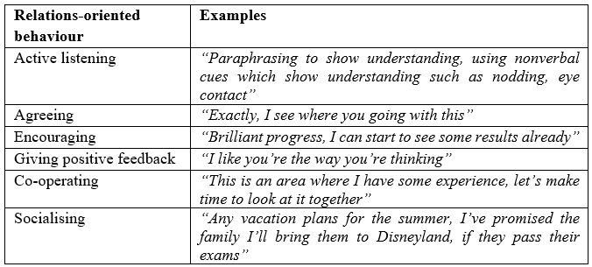
Values & Behaviours of Lean Leaders
Always remember, Employee Engagement is a Contact Sport
Notes:
See them as People not just Employees

Slide 13

Thank You

