Slide 1


WELCOME
ICBE Lunchtime Webinar
Using Your Strengths to
Re-Energise Yourself
& Unlock Potential
Thursday, October 6th @ 1pm
We will be starting in a few minutes
April
Where knowledge is shared and multiplied

Slide 2

Using your strengths to Re-Energise & Unlock Potential
ICBE Oct 6th 2022

Slide 3
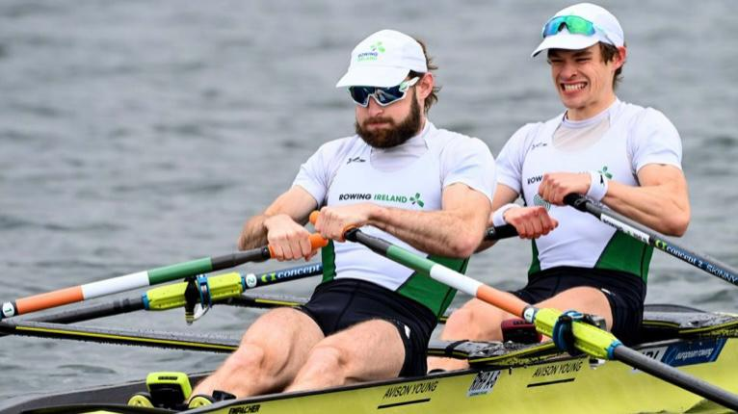
What is energy?
Pep in your step
Fire in your belly
Mojo back
Swagger
Buzz
Flow
Strengths in Action!

Slide 4
Strengths
Positive Psychology-Playing to our Strengths
Negativity Bias of our Brains

Slide 5
Negative Effects of pandemic on our Psyche.
Our capacity to be open to new concepts
Our tendency to reach out to others
Our desire to strive towards goals, do tasks well, take responsibility.
Ref; Dr Jolanta Burke, RCSI Health Sciences 28 Sep 2022

Slide 6



Defining Strengths
Performance
Energy
Use
How well you perform when using these strengths
How energised you are by using these strengths
How often you use these strengths
Source Cappfinity

Slide 7
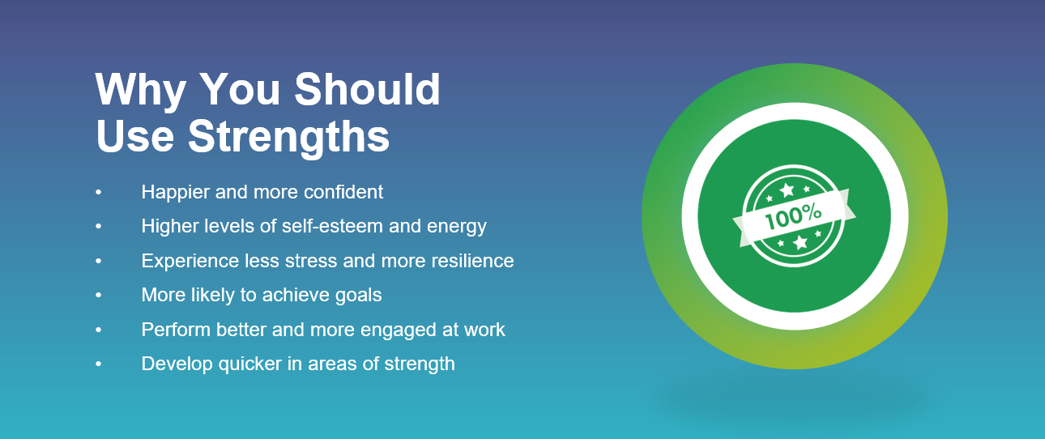
Benefits of Strengths
Source; Cappfinity

Slide 8
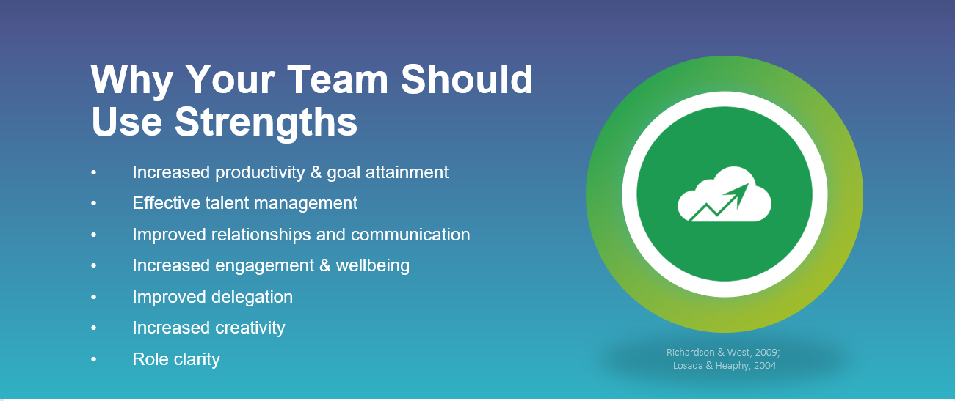
Benefits of strengths
Source; Cappfinity

Slide 9
Benefits Of strengths
Results
42% high performers say managers talk about strengths
6% increase in employee engagement
7.8% increase in productivity
54% positive change in perception of employer
Source; Cappfinity

Slide 10
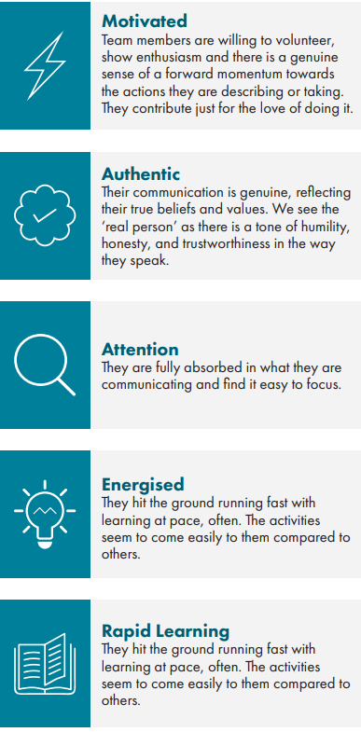
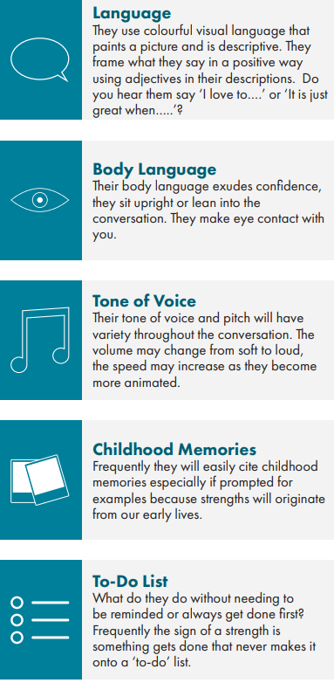
Strengths spotting ref; Strengths profile White Paper, Capp & Co Ltd 2018

Slide 11
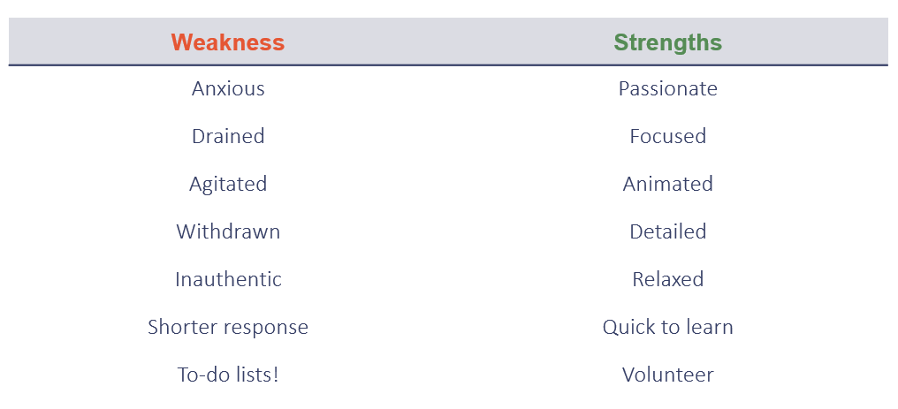
Strength Spotting
Source; Cappfinity

Slide 12
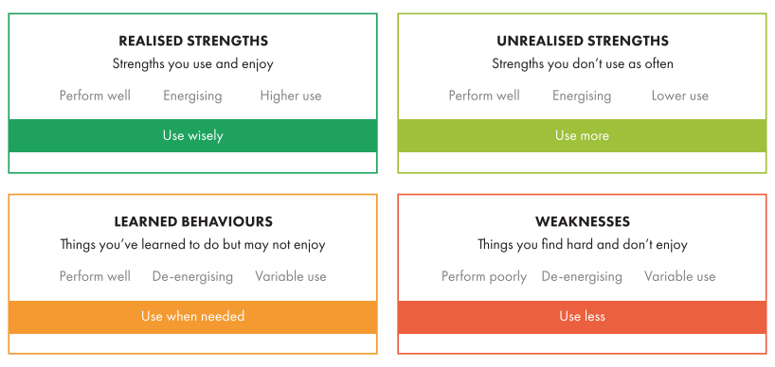
Unlocking potential
Source; Cappfinity

Slide 13
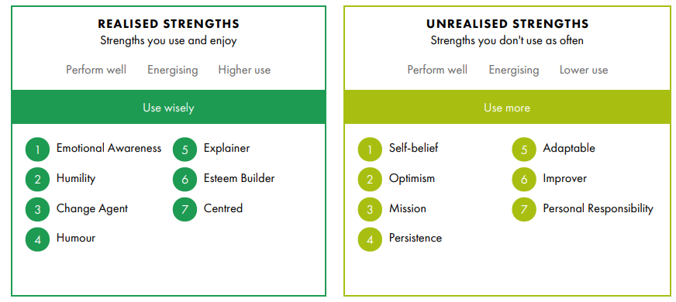
Unblocking potential & development

Slide 14
Summary
Understand who we are and what we are capable of!
Confidence when we truly recognise and utilise our strengths
Celebrate our uniqueness
Show up and be our Best Selves!

Slide 15
Thank You!

Slide 16
Website: icbe.ie
LinkedIn: Irish Centre for Business Excellence
Twitter: @ICBE_Business

